Slide 1
Battle of the neighborhoods
Where is my Pizza Place??

Slide 2
Contents
Introduction
1
Methodology
2
Results
3

Slide 3
“Pizza makes everything possible”
—Someone famous

Slide 4
1. Introduction

Slide 5
Introduction
Let's say you want to start a little pizza place in Stockholm, Sweden. But you don't have the resources to compete with the major fast food companies and you also want as little competition as possible in your local area.
Where should you go, and look for a place to rent?
In this assignment, I will try to find the best place in Stockholm to start a little pizza place where there is little competition but as close as the city center as possible with the assumption that the population density is higher the closer to the city center we get.

Slide 6
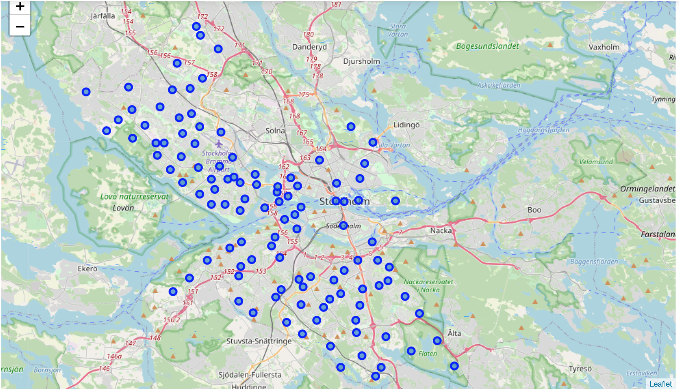
Stockholm neighborhoods

Slide 7
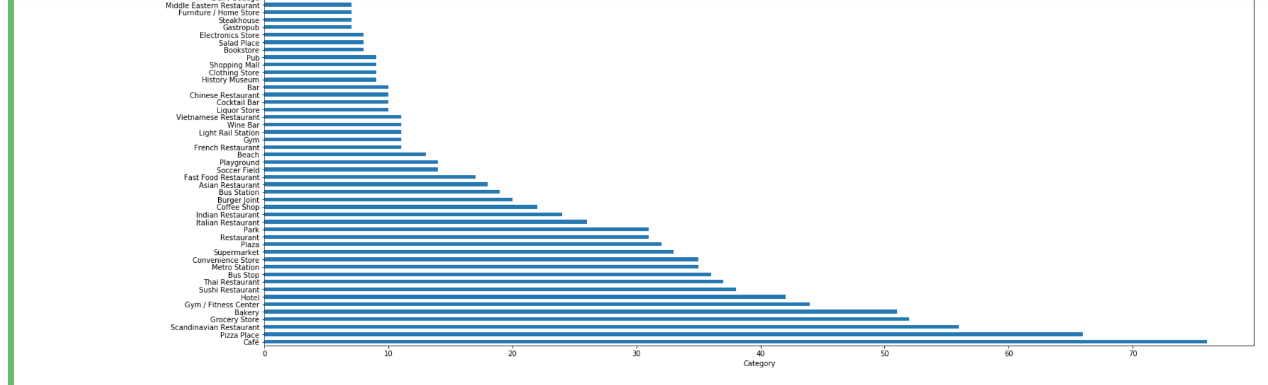
Top venues categories

Slide 8
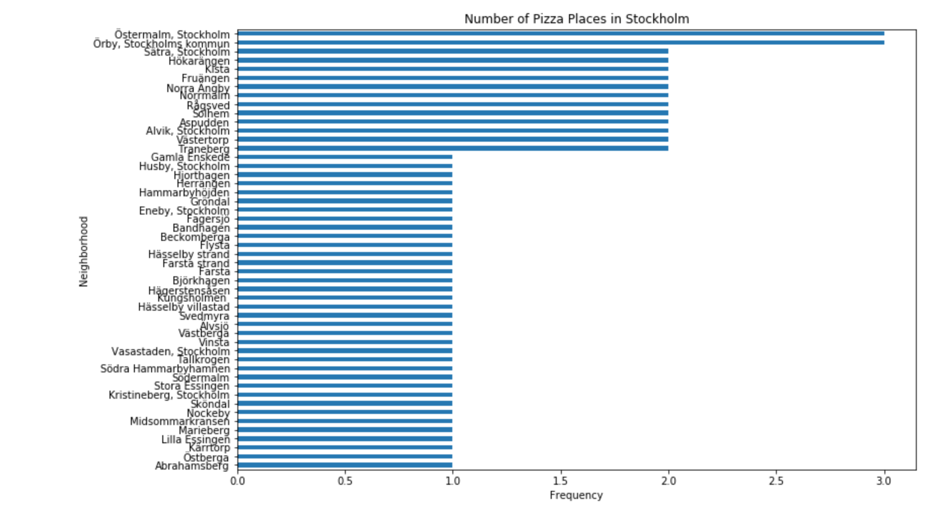
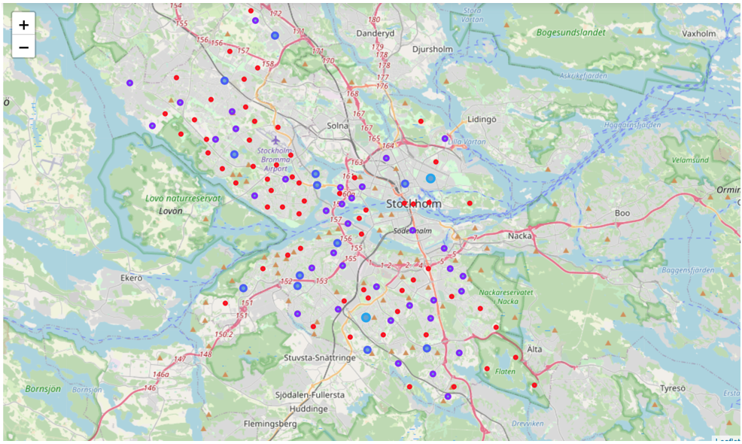
Pizza Places today

Slide 9
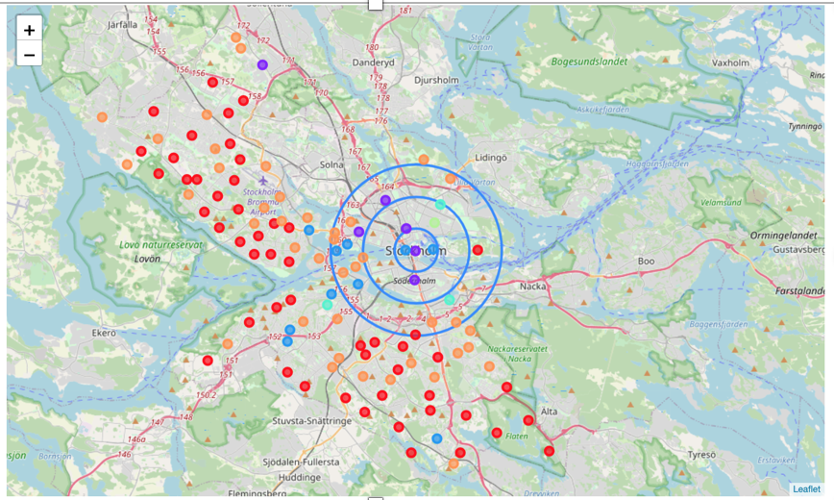
Results

Slide 10
Results
By looking at this we would choose to look furher into the red and orange markers close to the city centre.
Långholmen and Djurgården is our best options based on this analysis. Since I live in Stockholm i know that there isn't many people living on Djurgården or Långholmen and I wood rather choose another location based on the map above.
Stadshagen or Johanneshov would be great alternatives with lots of people living nearby but not many restaurants or pizza places. Therefore the next step in this analysis is to add the population density or maybe where people are moving.

